Slide 1
The Underpinning of Space Security in General International Law
Peter HULSROJ
Director
European Space Policy Institute
24 August 2015
Geneva

Slide 2
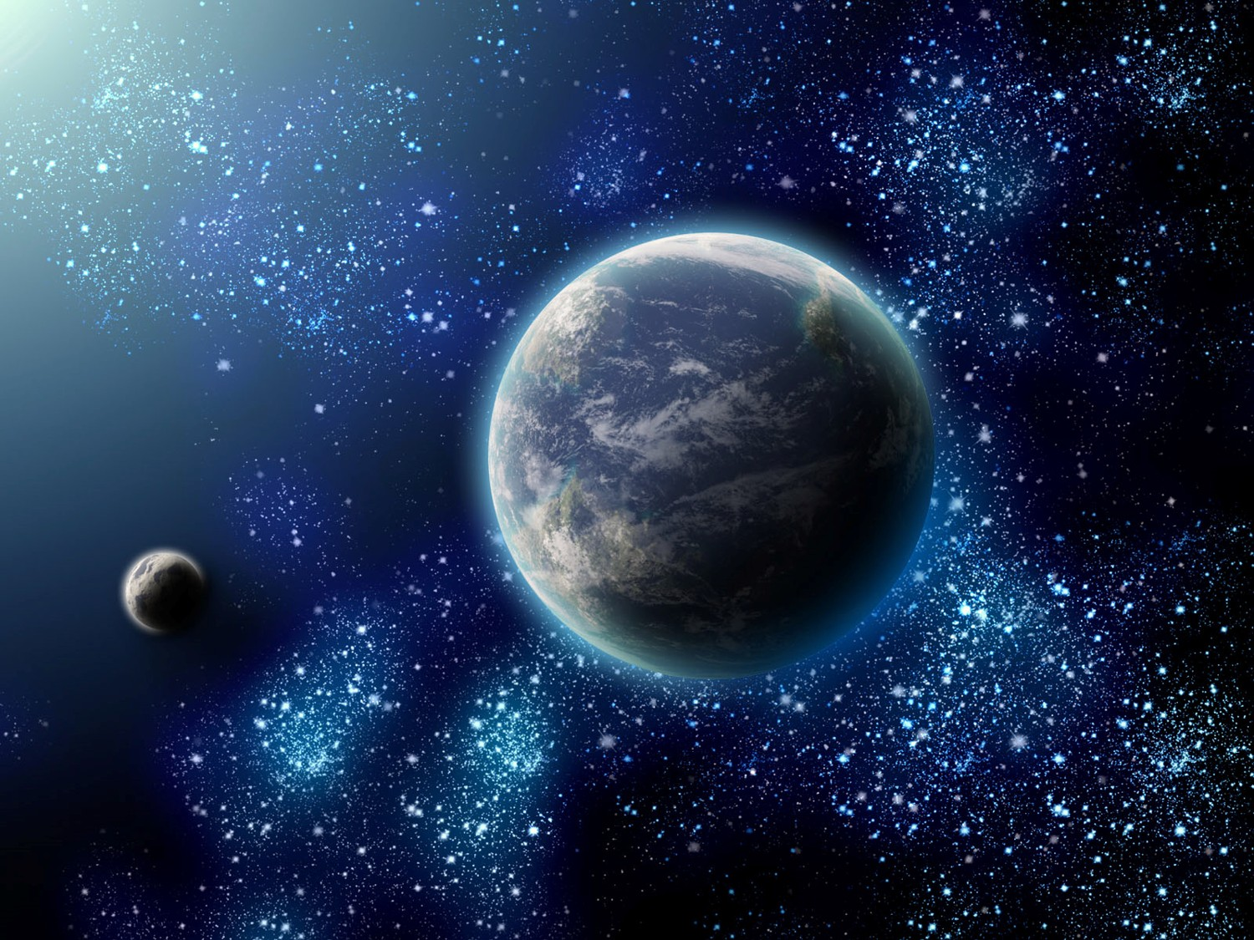
The normative Universe

Slide 3
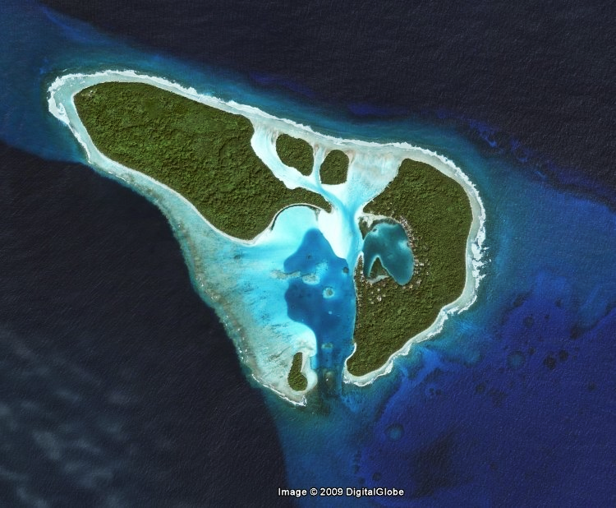
The space treaties island

Slide 4
The normative Universe

Slide 5
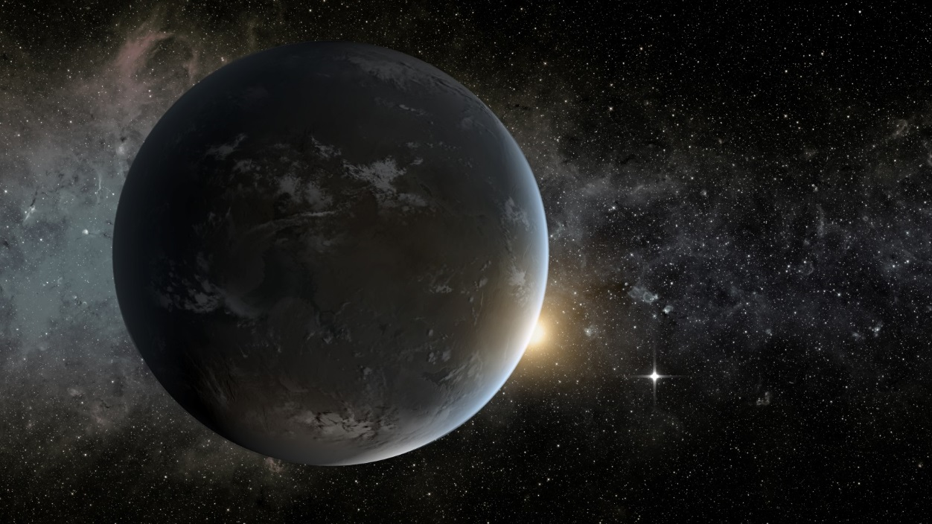
A world of international justice

Slide 6
A world that is perceived as unjust is inherently unstable
The equilibrium of normative systems

Slide 7
The normative Universe

Slide 8
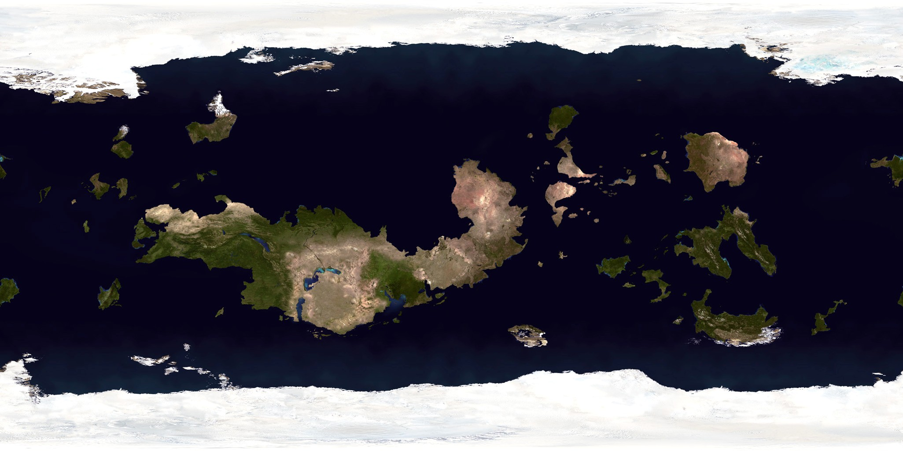
The continent of general international law

Slide 9
Death to the Lotus case principle!
The inter-connectedness of rules

Slide 10
The normative Universe

Slide 11
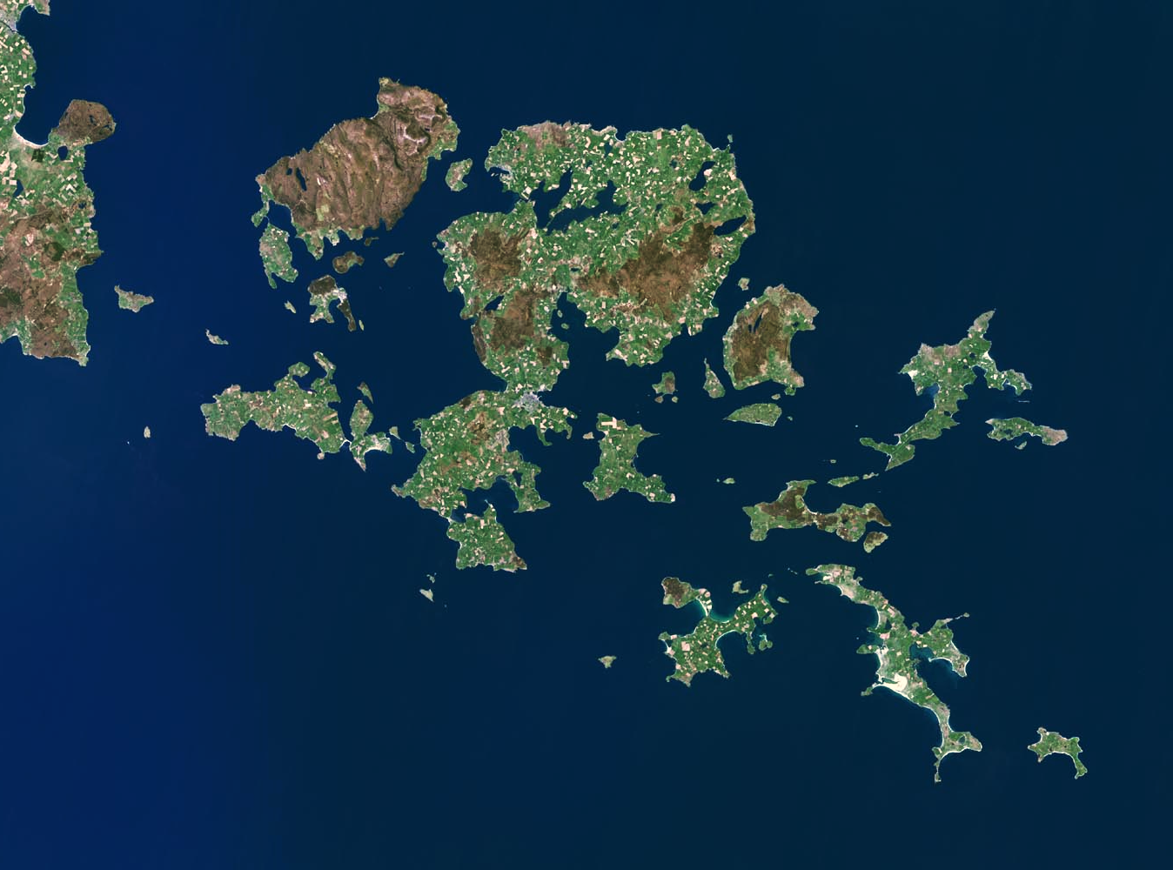
The region of
Good neighbour rules,
International responsibility,
Rules of war,
International Environmental Law

Slide 12
Legitimate targets in space and the laws of war
The potency of good neighbour principles
The potency of international environmental law
The UN Charter – and Security Council

Slide 13
Nuclear Test Case - Application by New Zealand:
28. It is the contention of New Zealand that this law and related rules and principles of international law are now violated by nuclear testing undertaken by the French Government in the South Pacific region. Inter alia,
(a) it violates the rights of all members of the international community, including New Zealand, that no nuclear tests that give rise to radioactive fallout be conducted;
(b) it violates the rights of all members of the international community, including New Zealand, to the preservation from unjustified artificial radioactive contamination of the terrestrial, maritime and aerial environment and, in particular, of the environment of the region in which the tests are conducted and in which New Zealand, the Cook Islands, Niue and the Tokelau Islands are situated;
(c) it violates the right of New Zealand that no radioactive material enter the territory of New Zealand, the Cook Islands, Niue or the Tokelau Islands, including their air space and territorial waters., as a result of nuclear testing;
(d) it violates the right of New Zealand that no radioactive material, having entered the territory of New Zealand, the Cook Islands, Niue or the Tokelau Islands, including their air space and territorial waters, as a result of nuclear testing, cause harm, including apprehension, anxiety and concern, to the people and Government of New Zealand and of the Cook lslands, Niue and the Tokelau Islands;
(e) it violates the right of New Zealand to freedom of the high seas, including freedom of navigation and overflight and the freedom to explore and exploit the resources of the sea and the seabed, without interference or detriment resulting from nuclear testing.

Slide 14
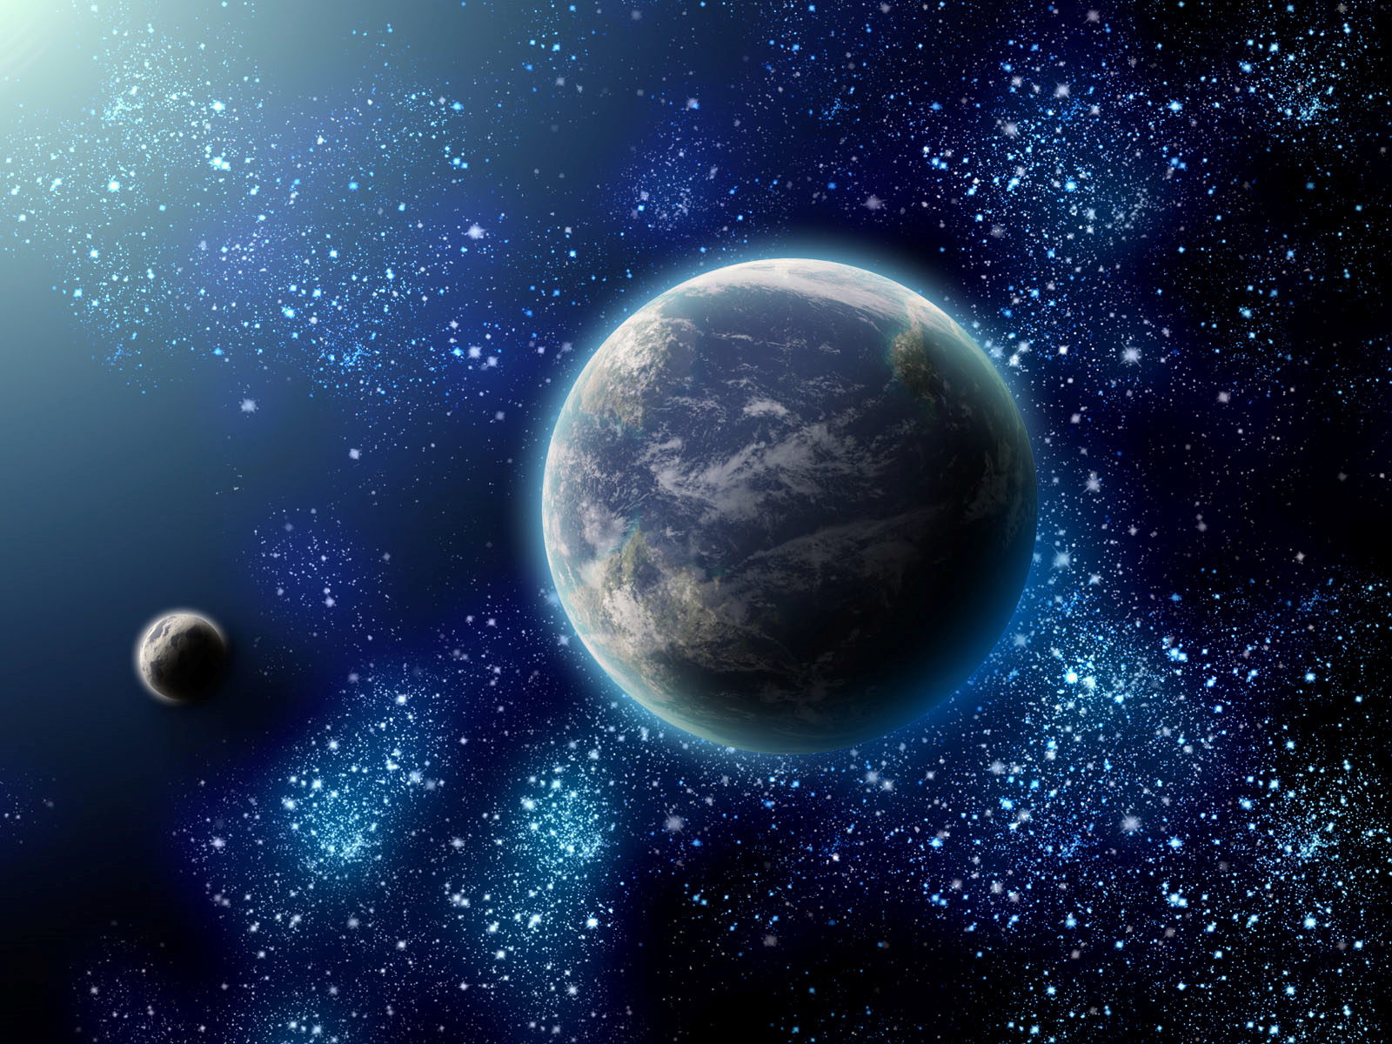
The normative Universe

Slide 15
The space treaties island

Slide 16
Free access to space is not the same as access to space
UN as an enabler of access to space
When all have a stake in space, security is easier to achieve
Do we milk the space treaties for all they have in terms of space security?, Outer Space Treaty, Arts III and IX
Is soft law ‘the end of history’?
Building strong space security through domestic legislation

