Slide 1
Is Spectrum Shifting the Playing Field
for the Weather Enterprise?
Spectrum Considerations for Weather
Satellite End Users
Joint Satellite Conference Panel
October 1, 2019
Slides from OTR-2019-00947 Approved for Public Release

Slide 2
Scenarios without and with IMT-2020
Animation indicates how 5G may impact EESS

Slide 3
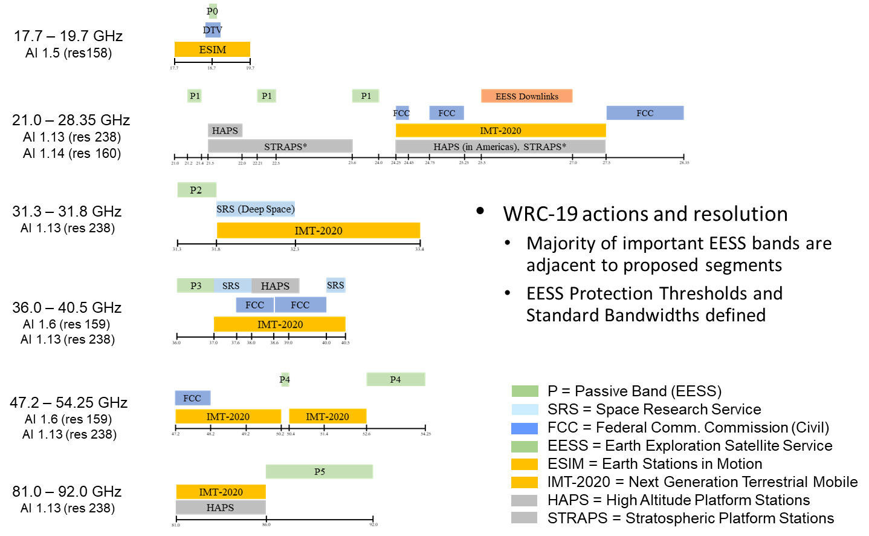
Proposed Sharing or Adjacent Band Scenarios
IMT-2020 (5G) and High Altitude Platform Proposed Use
WRC-19 proposed actions

Slide 4
International: ITU Studies Leading to WRC-19
The 24 GHz Band Is included in Agenda Item 1.13 and studied by Task Group 5/1
ITU-R Task Group 5/1 was requested to conduct sharing and compatibility studies and to develop the text for the ITU Conference Preparatory Meeting in time for WRC-19
US TG-5/1 effort
ITU
Conference Preparatory Meeting
Task Group 5/1
May 2016 – Aug 2018
2nd Session Feb 18-28 2019
Regional preparation
For WRC-19
Six Regional Groups:
APT
ASMG
ATU
CEPT
CITEL
RCC
Inter-American
Telecommunications
Commission (CITEL)
June 2016-Aug 2019
ITU Radio Regulations
International Radio Regulations Will Be Modified As A Result of WRC-19
Int’l 24 GHz adjacent band emissions levels will be selected at WRC-19.

Slide 5
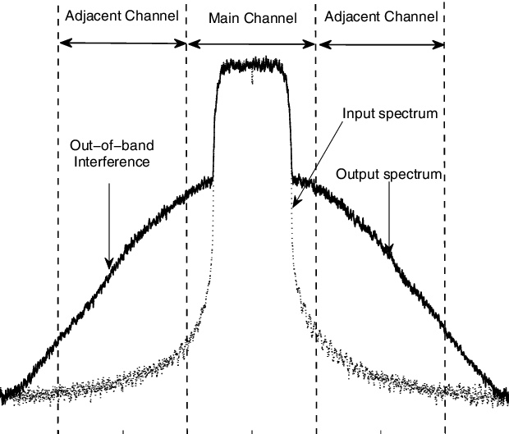
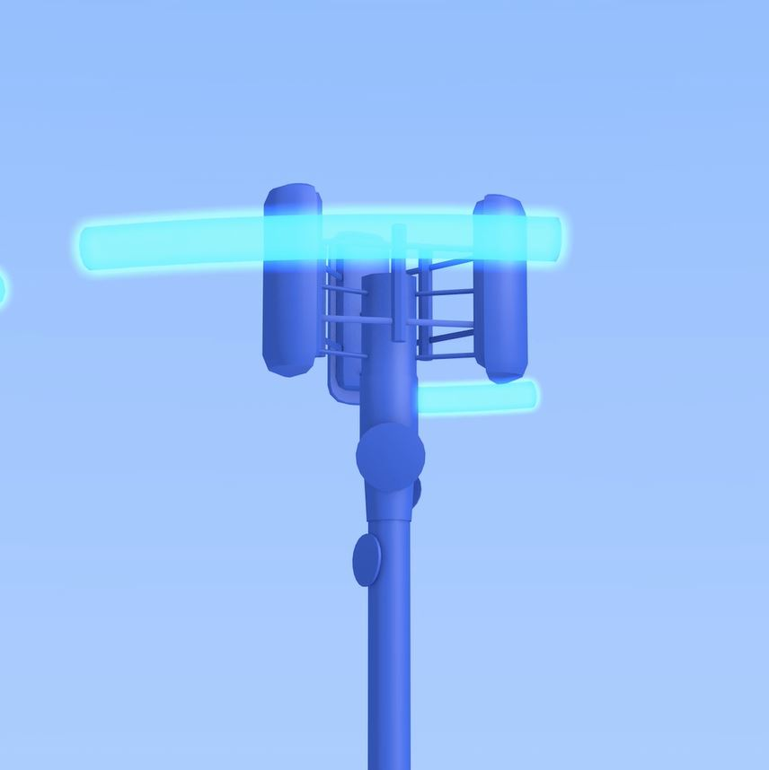
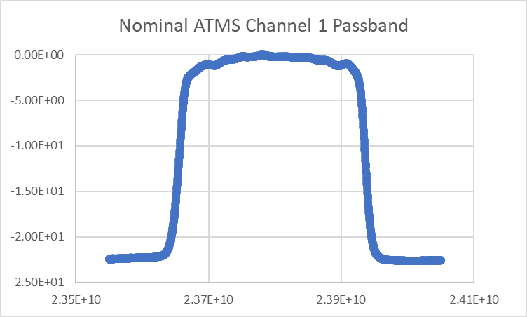
5G System Transmissions
References from NOAA STAR and FCC
§30.203: The conductive power or the total radiated power of any emission outside a licensee's frequency block shall be −13 dBm/MHz or lower
Total radiated out-of-band power levels from each Base Station (after ohmic losses)
Integrate over 200 MHz to derive -20dBW/200MHz
Impact to EESS is variable due to dynamic system attributes and waveform power amplifier operating characteristics
Low OOBE waveform
–20dBW/ 200 MHz
High OOBE Waveform
–13dBm/MHz
f(GHz)
23.8
24.3
24.8
§30.202: For fixed and base stations … the average power of the sum of all antenna elements is limited to an equivalent isotopically radiated power (EIRP) density of +75dBm/100 MHz
ATMS Response in this region may be as high as -22.5 dB
Need to consider IMT in-band and out-of-band emissions to fully assess impact to ATMS and other EESS sensors

Slide 6
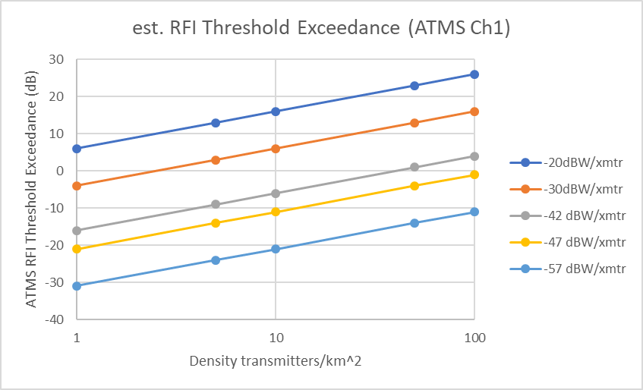
ATMS Channel 1 RFI Threshold
EESS In-band power per 5G transmitter vs. density of transmitters
FCC prop. level
CEPT rec. level
Original level
-52 to -57 dBW rec.
Interference-free
RFI Thresholds
0.1*NEDT
RFI Threshold at 0.1*NEDT; Antenna characteristics: 30.4 dBi Gain, beam width = 5.2° ​
-166 dBW
Items in Pink Region Exceed Sensitivity Threshold of ATMS Sensor in 23-6-24 GHz and will interfere with passive sensing

Slide 7
What does the RFI Threshold Chart Mean?
Read The Chart As Follows:
The horizontal line labeled “0” represents the level at which interference would be harmful to a 23.8 GHz band passive sensor
Each of the colored lines crossing the chart at an angle represent the various protection limits levels that could be applied to 5G
The X-axis represents the uniform density of 5G transmitters (per sqkm) within the microwave sensor’s footprint -- starting with 1 at the left and 100 at the right within a given area
Note that the -47 dBW values will begin to cause RFI if 5G transmitter density reaches ~100 within a square kilometer
Reduced protection value proposals (-20 to -42dBW/200MHz) encounter the interference threshold with fewer and fewer transmitters.
Adjacent band emissions at the current -20 dBW value will cause interference at < 1 emitter/sqkm(!)
The -47 dB values and below are more likely to protect passive sensing in this band from adjacent band radio frequency interference originating with dense urban 5G

Slide 8
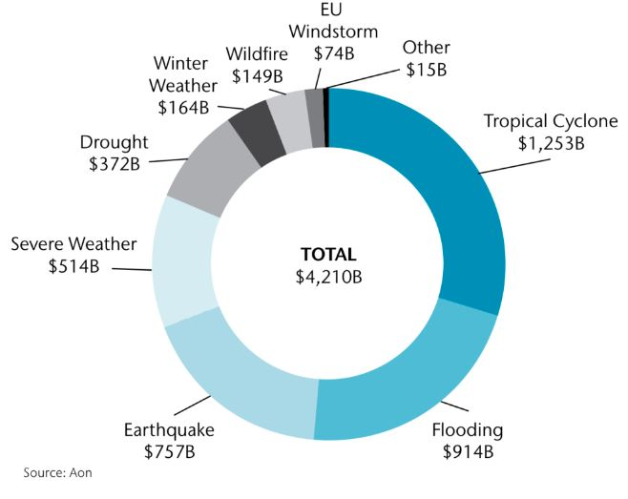
Economic Impacts of Extreme Weather and Natural Disasters
We understand better the economic value of 5G – but what about weather costs?
Extreme Weather in 2018 cost $160 billion USD [Munich Re]
2017 – 2018 was the costliest two-year period on record at $ 653 billion USD [Aon]
Adding in natural disasters for 2018, increases that figure to $ 235 billion USD
More than 10,000 people lost their lives to natural disasters in 2018
A clear question is how would these facts be altered if the weather forecasts and warnings were to be degraded due to passive band interference?

